Slide 1
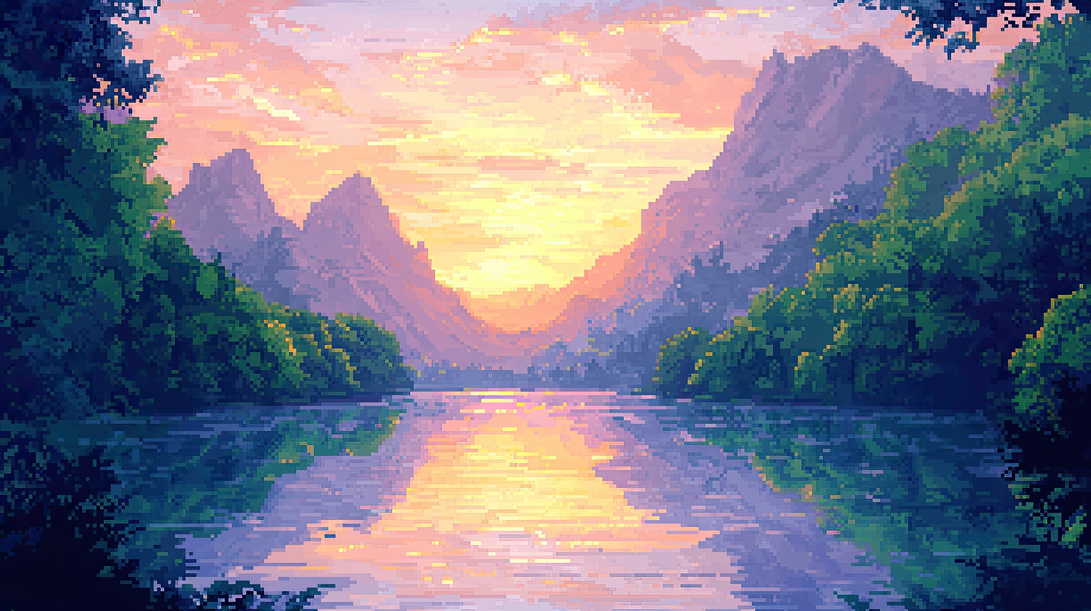

Golden Hour by JVKE

Slide 2
It was just two lovers

Slide 3
Sittin’ in the car, listening to blonde

Slide 4
Fallin’ for each other

Slide 5
Pink and orange skies

Slide 6
Feelin’ super childish

Slide 7
No Donald Glover

Slide 8
Missed call from my mother

Slide 9
Like, “where you at tonight?”

Slide 10
Got no alibi

Slide 11
I was all alone with the love of my life

Slide 12
She’s got glitter for skin

Slide 13
My radiant beam in the night

Slide 14
I don’t need no light to see you

Slide 15
Shine

Slide 16
It’s your golden hour (oh)

Slide 17
You slow down time

Slide 18
In your golden hour (oh)

Slide 19
We were just two lovers

Slide 20
Feet up on the dash,

Slide 21
Drivin’ nowhere fast

Slide 22
Burnin’ through the summer

Slide 23
Radio on blast, make the moment last

Slide 24
She got solar power

Slide 25
Minuites feel like hours

Slide 26
She knew she was the baddest

Slide 27
Can you even imagine

Slide 28
Fallin’ like I did?

Slide 29
For the love of my life

Slide 30
She’s got glow on her face

Slide 31
A glorious look in her eyes

Slide 32
My angel of light

Slide 33
I was all alone with the love of my life

Slide 34
She’s got glitter for skin

Slide 35
My radiant beem in the night

Slide 36
I don’t need no light to see you

Slide 37
Shine

Slide 38
It’s your golden hour (oh)

Slide 39
You slow down time

Slide 40
In your golden hour (oh)

Slide 41
(Musical)

